Slide 1

Resolve UK
See it. Report it. Resolve it.
The UK's first national environmental accountability platform — combining citizen engagement, AI verification and transparent resolution tracking to make communities cleaner, safer and more accountable.
SOCIAL ENTERPRISE · CIVIC TECHNOLOGY

Slide 2

The Problem
Millions of environmental issues are reported across the UK every year — yet citizens rarely know what happens next. Fragmented systems, inconsistent accountability and a lack of transparency leave communities feeling unheard.
1M+ Fly-Tipping Incidents
Reported annually across the UK
Hundreds of Thousands
Of pothole complaints go unresolved
Fragmented Reporting
No consistent national system or accountability
Zero Transparency
Citizens report — nobody knows what happens next

Slide 3


The Real Cost of Inaction
Environmental blight is not just an aesthetic problem — it carries measurable economic, social and civic costs that compound over time.
Higher Clean-Up Costs
Vehicle Damage & Insurance Claims
Reduced Property Values
Erosion of Public Trust
Delayed resolution multiplies remediation expenditure for councils and housing associations
Persistent environmental blight depresses local housing markets
Unresolved reports undermine confidence in local government
Potholes and infrastructure failures generate significant liability costs

Slide 4
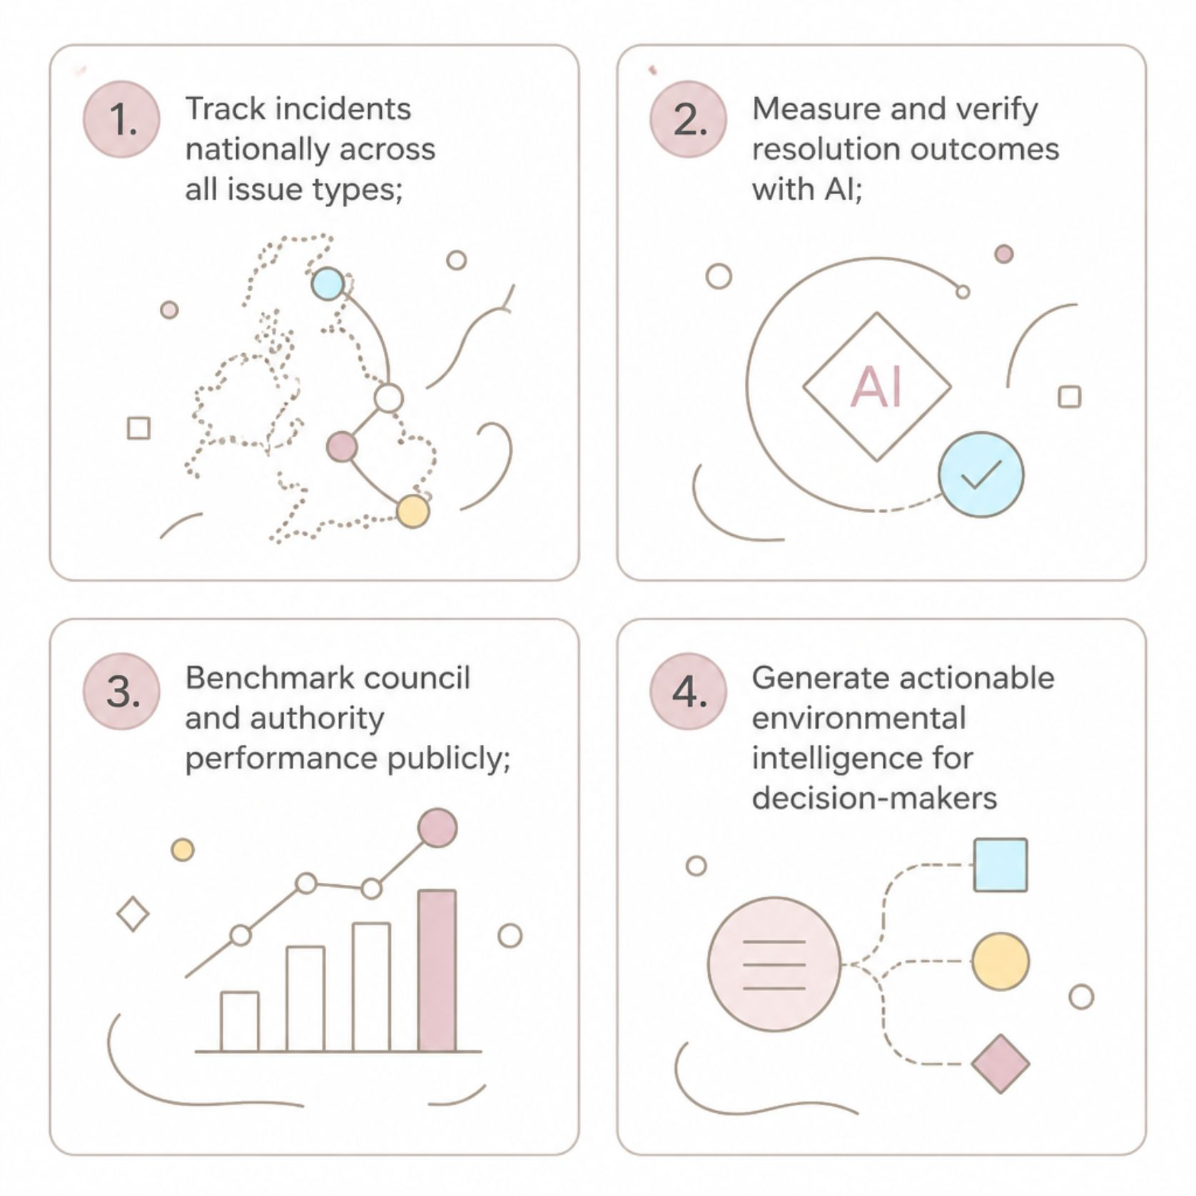
The Gap in the Market
The UK lacks a national platform that connects citizen reporting with verifiable resolution, performance benchmarking and actionable environmental intelligence. Existing tools stop at reporting — Resolve UK goes further.
What's Missing Today
Current solutions — from FixMyStreet to council CRM systems — capture reports but fail to close the loop. There is no national standard for resolution tracking, no AI-powered verification and no public benchmarking of authority performance.
This is the opportunity: FixMyStreet + Intelligence + Accountability

Slide 5






Our Solution
Resolve UK is a free citizen platform backed by a powerful intelligence layer — from first report to verified resolution with national dashboards that hold authorities accountable.
Simple Reporting
Citizens report issues in seconds via web or mobile
AI Categorisation
Automatic classification and priority scoring
Automatic Routing
Issues sent directly to the responsible authority
Resolution Tracking
Live status updates visible to all stakeholders
AI Verification
Outcomes confirmed, not just claimed
National Dashboards
Public benchmarking and environmental intelligence

Slide 6

Why We Win
Resolve UK is not a reporting app. It is an accountability and intelligence platform — a fundamentally different category that avoids direct competition while serving every stakeholder in the environmental resolution chain.
The Competitive Landscape
Capability | Existing Players | Resolve UK
Reporting | ✓ | ✓ + Resolution
Scope | Individual cases | National intelligence
Benchmarking | ✗ | Public benchmarks
Verification | ✗ | AI-verified
Orientation | Council-centric | Community-centric
Approach | Reactive | Predictive
FixMyStreet is trusted but limited to reporting. Fill That Hole addresses only potholes. Love Clean Streets is council software, not a national platform. Snap Send Solve (Australia) is the closest international comparable — but lacks an intelligence layer.
Resolve UK = FixMyStreet + Intelligence + Accountability

Slide 7

Market Size & Business Model
Total Addressable Market
Revenue Streams
Resolve UK's TAM exceeds £100 million, spanning a diverse and growing set of institutional customers who need environmental data, accountability tools and ESG reporting capabilities.
The citizen platform is free — removing all barriers to adoption. Revenue is generated from institutional customers who benefit from the intelligence layer.
317 Local Authorities
Housing Associations
Waste Operators
BIDs, Universities & Insurers
Primary SaaS customers
Biffa, Veolia, FCC Environment
National and regional operators
Extended enterprise market
SaaS Subscriptions
Benchmarking & Analytics
Authority and enterprise licences
Performance data and comparative reports
API Access
ESG Partnerships & Sponsorship
Integration for waste operators and insurers
Corporate environmental accountability programmes

Slide 8





Social Impact
Resolve UK is a social enterprise. Every feature, every partnership and every pound of revenue is designed to generate measurable public benefit — not just shareholder value.
Cleaner Communities
Faster resolution of fly-tipping, litter and environmental blight across all issue types
Improved Transparency
Public dashboards hold authorities accountable and rebuild civic trust
Better Use of Public Funds
Data-driven prioritisation reduces waste and directs resources where they are needed most
Community Engagement
Citizens become active participants in shaping their local environment

Slide 9
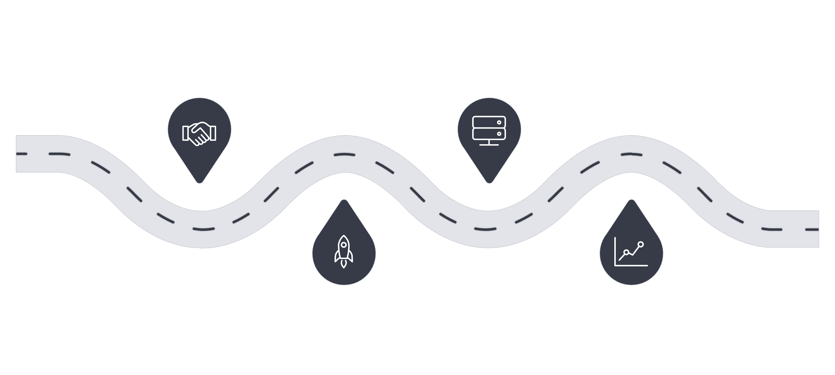
Pilot Programme
We are seeking partners for a structured 12-month pilot to validate the platform, demonstrate impact and build the evidence base for national rollout. Pilot partners will receive dedicated support, co-branding and early access to benchmarking data.
Onboarding
Scale
3 authorities & 1 housing partner (M1–3)
50,000 incidents; AI verification (M7–9)
Launch
Evaluate
Citizen platform, 5,000 users (M4–6)
National dashboard & scale prep (M10–12)
The pilot is designed to generate rigorous, publishable evidence of resolution rates, cost savings and citizen satisfaction — creating a compelling case for wider adoption.
3
5K
Pilot Authorities
Target Users
Plus 1 housing association
Active citizen reporters
50K
12
Incidents
Months
Tracked and resolved
Structured pilot duration

Slide 10
Investment Ask:

